Slide 1






Introduction to Entity Framework
ORM Concepts, CRUD Operations
Entity
Framework
SoftUni Team
SQL
Technical Trainers
Software University
http://softuni.bg

Slide 2

Table of Contents
ORM Technologies – Basic Concepts
Entity Framework – Overview
Reading Data with EF
CRUD Operations Using Entity Framework
Working with LINQ

Slide 3
Questions
sli.do #Entity

Slide 4
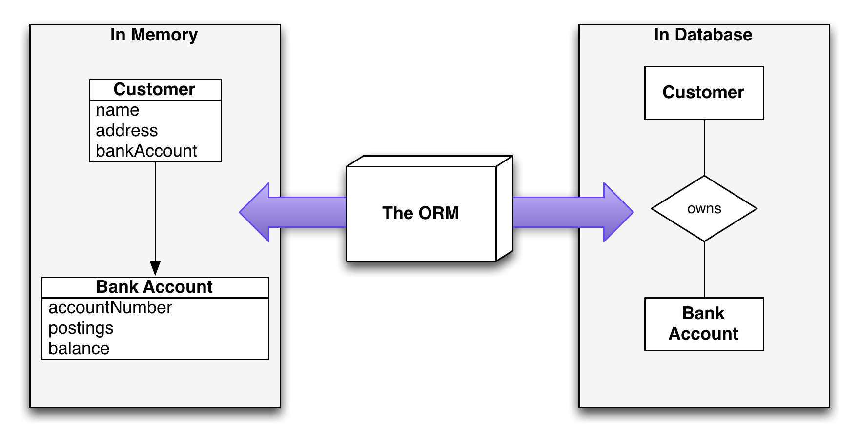
Introduction to ORM
Object-Relational Mapping

Slide 5
ORM Frameworks
Object-Relational Mapping (ORM) is a programming technique for automatic mapping of data and schema
Creates a "virtual object database" for the programming language
ORM frameworks automatically generate SQL to perform data operations
ORM frameworks typically provide the following functionality:
Creating object model by database schema (DB first model)
Creating database schema by object model (code first model)
Querying data by object-oriented API (e.g. LINQ queries)

Slide 6
ORM Advantages and Disadvantages
Object-relational mapping (ORM) advantages
Developer productivity: writing less code
Abstract from differences between object and relational world
Manageability of the CRUD operations for complex relationships
Easier maintainability
Disadvantages:
Reduced performance (due to overhead or incorrect ORM use)
Reduces flexibility (some operations are hard for implementing)

Slide 7
Entity Framework
Overview and Features

Slide 8
Overview and Features
Entity Framework (EF) is the standard ORM framework for .NET
Integrated with Visual Studio
Provides LINQ-based data queries and CRUD operations
Automatic change tracking of in-memory objects
Works with any relational database
Open source with independent release cycle
github.com/aspnet/EntityFramework

Slide 9
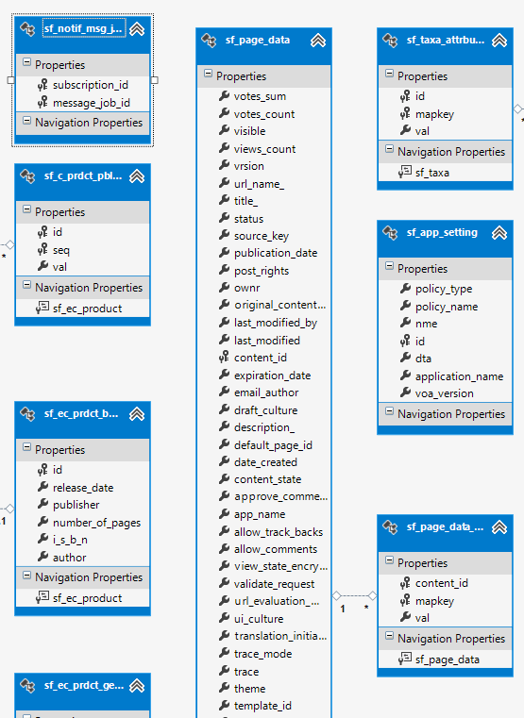
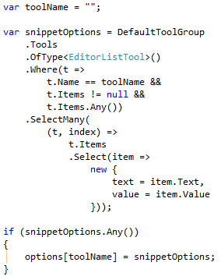
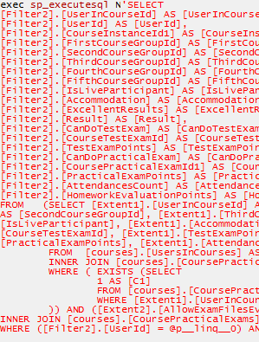
EF: Basic Workflow
Define the data model (use a DB Visual designer or code first)
Write & execute query over IQueryable
EF generates & executes an SQL query in the DB

Slide 10
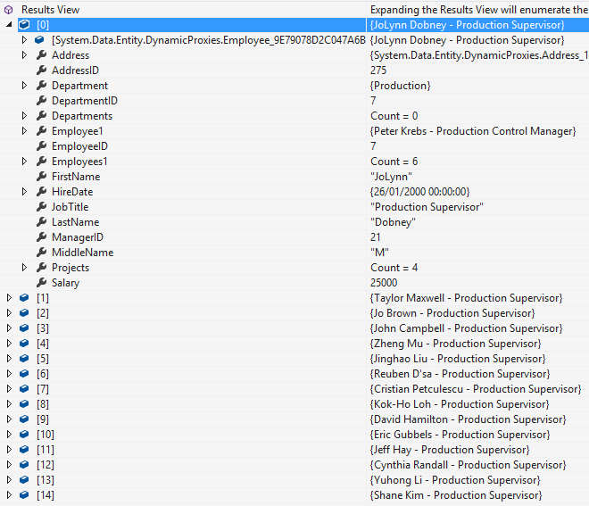
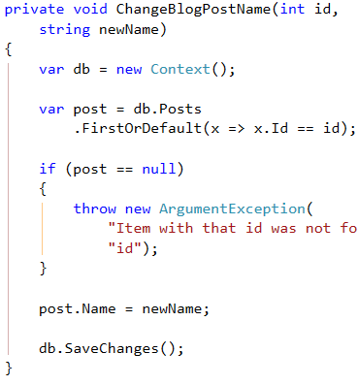
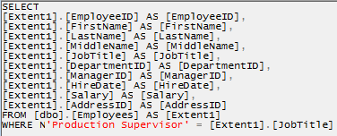
EF: Basic Workflow (2)
EF transforms the query results into .NET objects
Modify data with C# code and call "Save Changes"
Entity Framework generates & executes SQL command to modify the DB

Slide 11
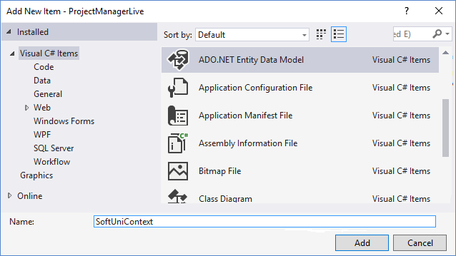
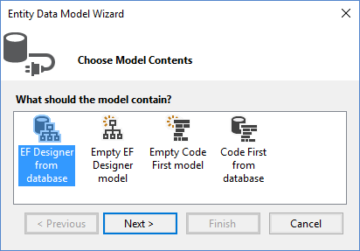
Entity Framework in Visual Studio
To add EF support to a project in Visual Studio:
Select Add → New Item… from the project's context menu
Chose
"From Database"
Select ADO.NET

Slide 12
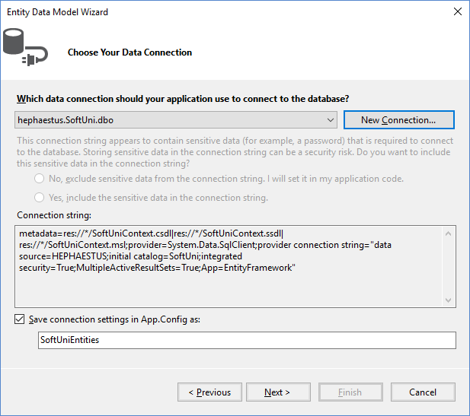
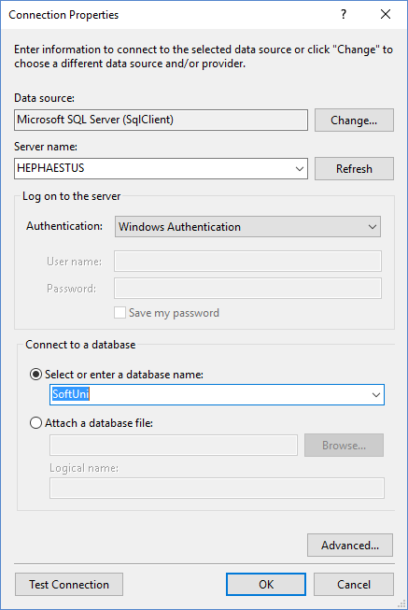
Entity Framework in Visual Studio (2)
Pick server
Select after creating
Pick database

Slide 13
EF Components
The DbContext class
DbContext holds the database connection and the entity classes
Provides LINQ-based data access
Implements identity tracking, change tracking, and API for CRUD operations
Entity classes
Hold entities (objects with their attributes and relations)
Each database table is typically mapped to a single C# entity class

Slide 14
EF Components (2)
Associations (relationship mappings)
An association is a primary key / foreign key-based relationship between two entity classes
Allows navigation from one entity to another
Concurrency control
Entity Framework uses optimistic concurrency control
No locking by default
Automatic concurrency conflict detection
var courses = student.Courses.Where(…);

Slide 15

Reading Data
Querying the DB using Entity Framework

Slide 16
The DbContext Class
The DbContext class is generated by the Visual Studio designer
DbContext provides:
Methods for accessing entities (object sets)
Methods for creating new entities (Add() methods)
Ability to manipulate database data though entity classes
Read, modify, delete, insert
Easily navigate through the table relationships
Executing LINQ queries as native SQL queries
Create the DB schema in the database server

Slide 17
Using DbContext Class
First create instance of the DbContext:
In the constructor you can pass a database connection string and mapping source
DbContext properties:
Connection – the SqlConnection to be used
CommandTimeout – SQL commands execution timeout in the DB
All entity classes (tables) are listed as properties
e.g. IDbSet<Employee> Employees { get; }
var softUniEntities = new SoftUniEntities();

Slide 18
Reading Data with LINQ Query
Executing LINQ-to-Entities query over EF entity:
Employees property in the DbContext:
using (var context = new SoftUniEntities())
{ var employees =
from e in context.Employees
where e.JobTitle == "Design Engineer"
select e; }
This will be translated to an SQL query by EF
public partial class SoftUniEntities : DbContext
{
public IDbSet<Employee> Employees { get; set; }
public IDbSet<Project> Projects { get; set; }
public IDbSet<Department> Departments { get; set; }
}

Slide 19
Reading Data with LINQ Query
We can also use extension methods for constructing the query
Find element by id
using (var context = new SoftUniEntities())
{
var employees = context.Employees
.Where(c => c.JobTitle == "Design Engineering")
.Select(c => c.FirstName)
.ToList();
}
This is called projection
ToList() method executes the query
using (var context = new SoftUniEntities())
{
var project = context.Projects.Find(2);
Console.WriteLine(project.Name);
}

Slide 20
LINQ: Simple Operations
Where()
Searches by given condition
First() / FirstOrDefault()
Gets the first matched element
Last() / LastOrDefault()
Gets the last matched element
Select()
Makes projection (conversion) to another type
OrderBy() / ThenBy() / OrderByDescending()
Orders a collection

Slide 21
LINQ: Simple Operations (2)
Any()
Checks if any element matches a condition
All()
Checks if all elements match a condition
Distinct()
Returns only the unique elements
Skip() / Take()
Skips or takes X number of elements

Slide 22
Logging the Native SQL Queries
Printing the native database SQL command behind a query:
Queries can be monitored with Express Profiler
var query = context.Employees;
Console.WriteLine(query.ToString());
https://expressprofiler.codeplex.com/

Slide 23
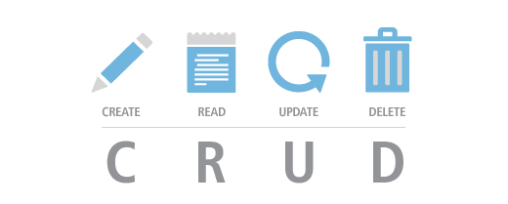
CRUD Operations
With Entity Framework

Slide 24
Creating New Data
To create a new database row use the method Add(…) of the corresponding collection:
Create a new project object
var project = new Project()
{
Name = "Judge System",
StartDate = new DateTime(2015, 4, 15),
};
context.Projects.Add(project);
context.SaveChanges();
Mark the object for inserting
Execute SQL statement

Slide 25
Cascading Inserts
We can also add cascading entities to the database:
The Project will be added when the Employee entity (employee) is inserted to the database
Employee employee = new Employee();
employee.FirstName = "Petya";
employee.LastName = "Grozdarska";
employee.Projects.Add(new Project { Name = "SoftUni Conf"} );
softUniEntities.Employees.Add(employee);
softUniEntities.SaveChanges();

Slide 26
Updating Existing Data
DbContext allows modifying entity properties and persisting them in the database
Just load an entity, modify it and call SaveChanges()
The DbContext automatically tracks all changes made on its entity objects
Employees employee =
softUniEntities.Employees.First();
employees.FirstName = "Alex";
context.SaveChanges();
This will execute an SQL SELECT to load the first order
This will execute an SQL UPDATE

Slide 27
Deleting Existing Data
Delete is done by Remove() on the specified entity collection
SaveChanges() method performs the delete action in the database
Mark the entity for deleting at the next save
Employees employee =
softUniEntities.Employees.First();
softUniEntities.Employees.Remove(employee);
softUniEntities.SaveChanges();
This will execute the SQL DELETE command

Slide 28

Summary
ORM frameworks map database schema to objects in a programming language
Entity Framework is the standard .NET ORM
LINQ can be used to query the DB
var employees = context.Employees
.Where(c => c.JobTitle == "Design Engineering")
.Select(c => c.FirstName)
.ToList();

Slide 29








Introduction to Entity Framework
https://softuni.bg/courses/

Slide 30
License
This course (slides, examples, demos, videos, homework, etc.) is licensed under the "Creative Commons Attribution-NonCommercial-ShareAlike 4.0 International" license
Attribution: this work may contain portions from
"Databases" course by Telerik Academy under CC-BY-NC-SA license

Slide 31




Free Trainings @ Software University
Software University Foundation – softuni.org
Software University – High-Quality Education, Profession and Job for Software Developers
softuni.bg
Software University @ Facebook
facebook.com/SoftwareUniversity
Software University Forums
forum.softuni.bg

